Slide 1


Data Science Programming CMP-262
Craig Dacosta
Notes:
Hi, my is Craig Dacosta and I this presentation is for Data science progamming class. In the beggining of the class when we introduce ourself, I mentioned I and soccer fan and you can find me on the couch on a Saturday and Sunday morning watching EPL. So with that said I decide to do my analyst on EPL.

Slide 2

English Premier League Player Stat 2023-2024 Season
Potential clients:
Fans
Football Team Clubs
Sports Analysts and Commentators
Betting Agencies
Fantasy Players
Value of the Analysis:
For Fans: Offers deeper insights into the game, enhancing engagement.
For Clubs: Helps in strategic planning, recruitment, and performance evaluation.
For Analysts: Provides meaningful statistics to support commentary and articles.
For Betting Agencies: Data-driven decisions to enhance prediction accuracy.
For Fantasy Players: Optimize team compositions for better results.

Slide 3
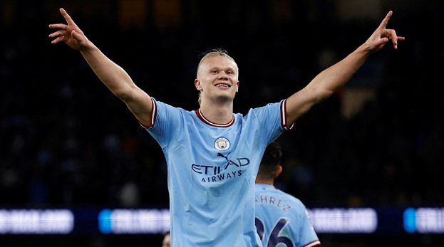
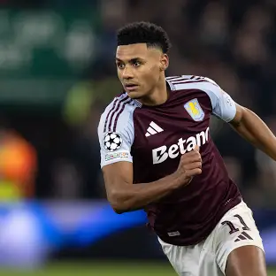
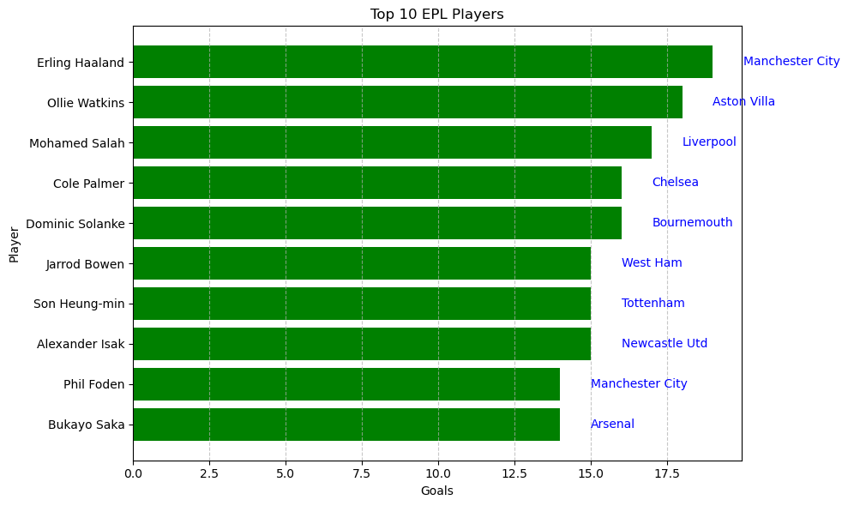
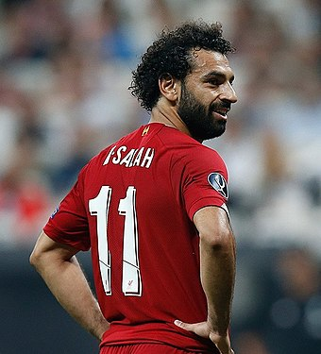
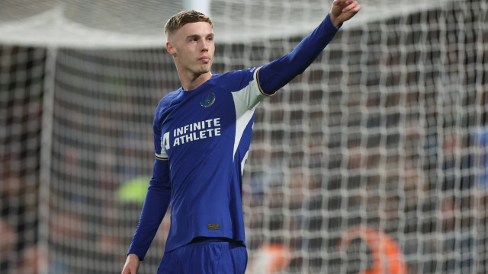
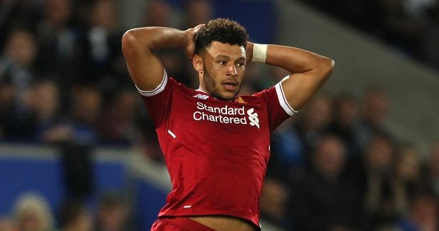
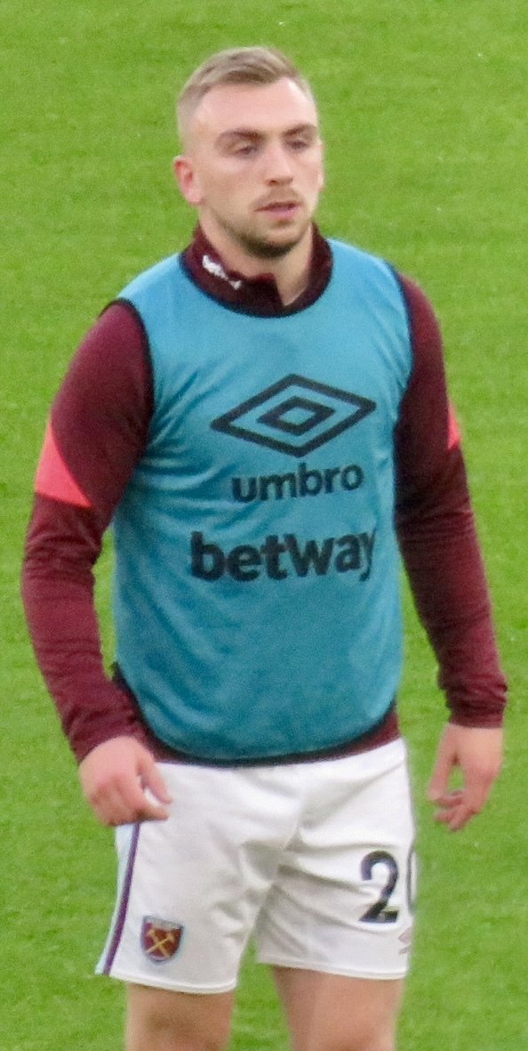
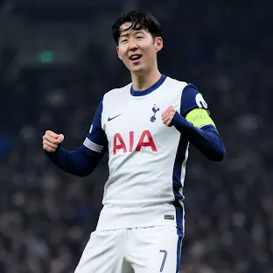
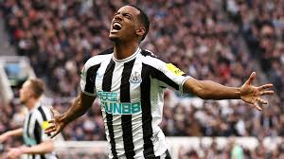
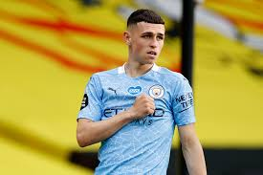
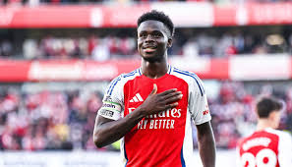
Who are the top 10 players based on goals scored

Slide 4

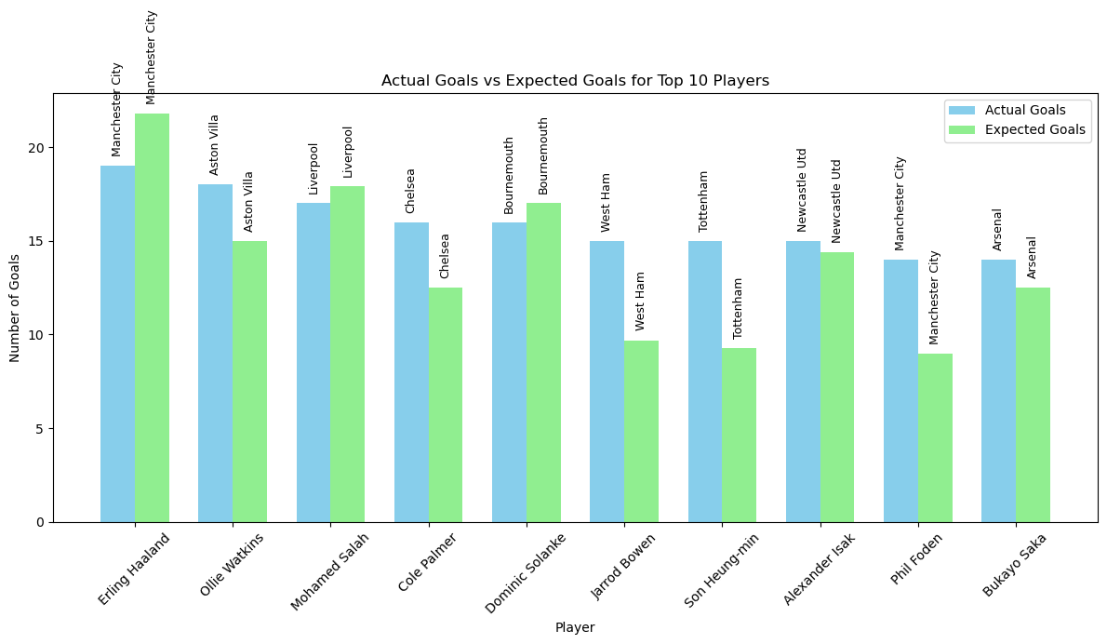
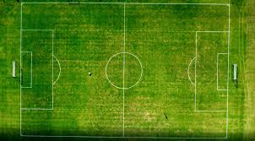
Comparison actual goals vs expected goals for top 10 players base on goals

Slide 5

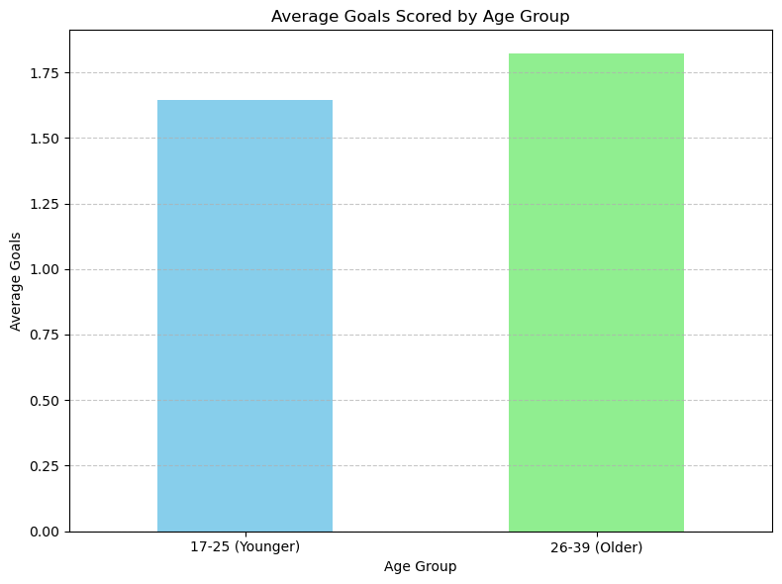

Does younger more physical player (age 17-25) score more goals than older more experience player (age 26-39)?

